Slide 1
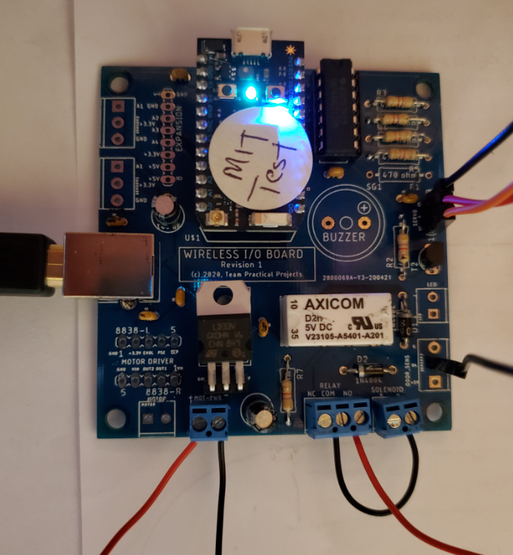
Ultrasound module “Gnd”
Ultrasound module “Vcc”
Ultrasound module “Trig”
Ultrasound module “Echo”
Opener Battery +
Opener Button
Opener Ground
Jumper – COM to board ground

Slide 2
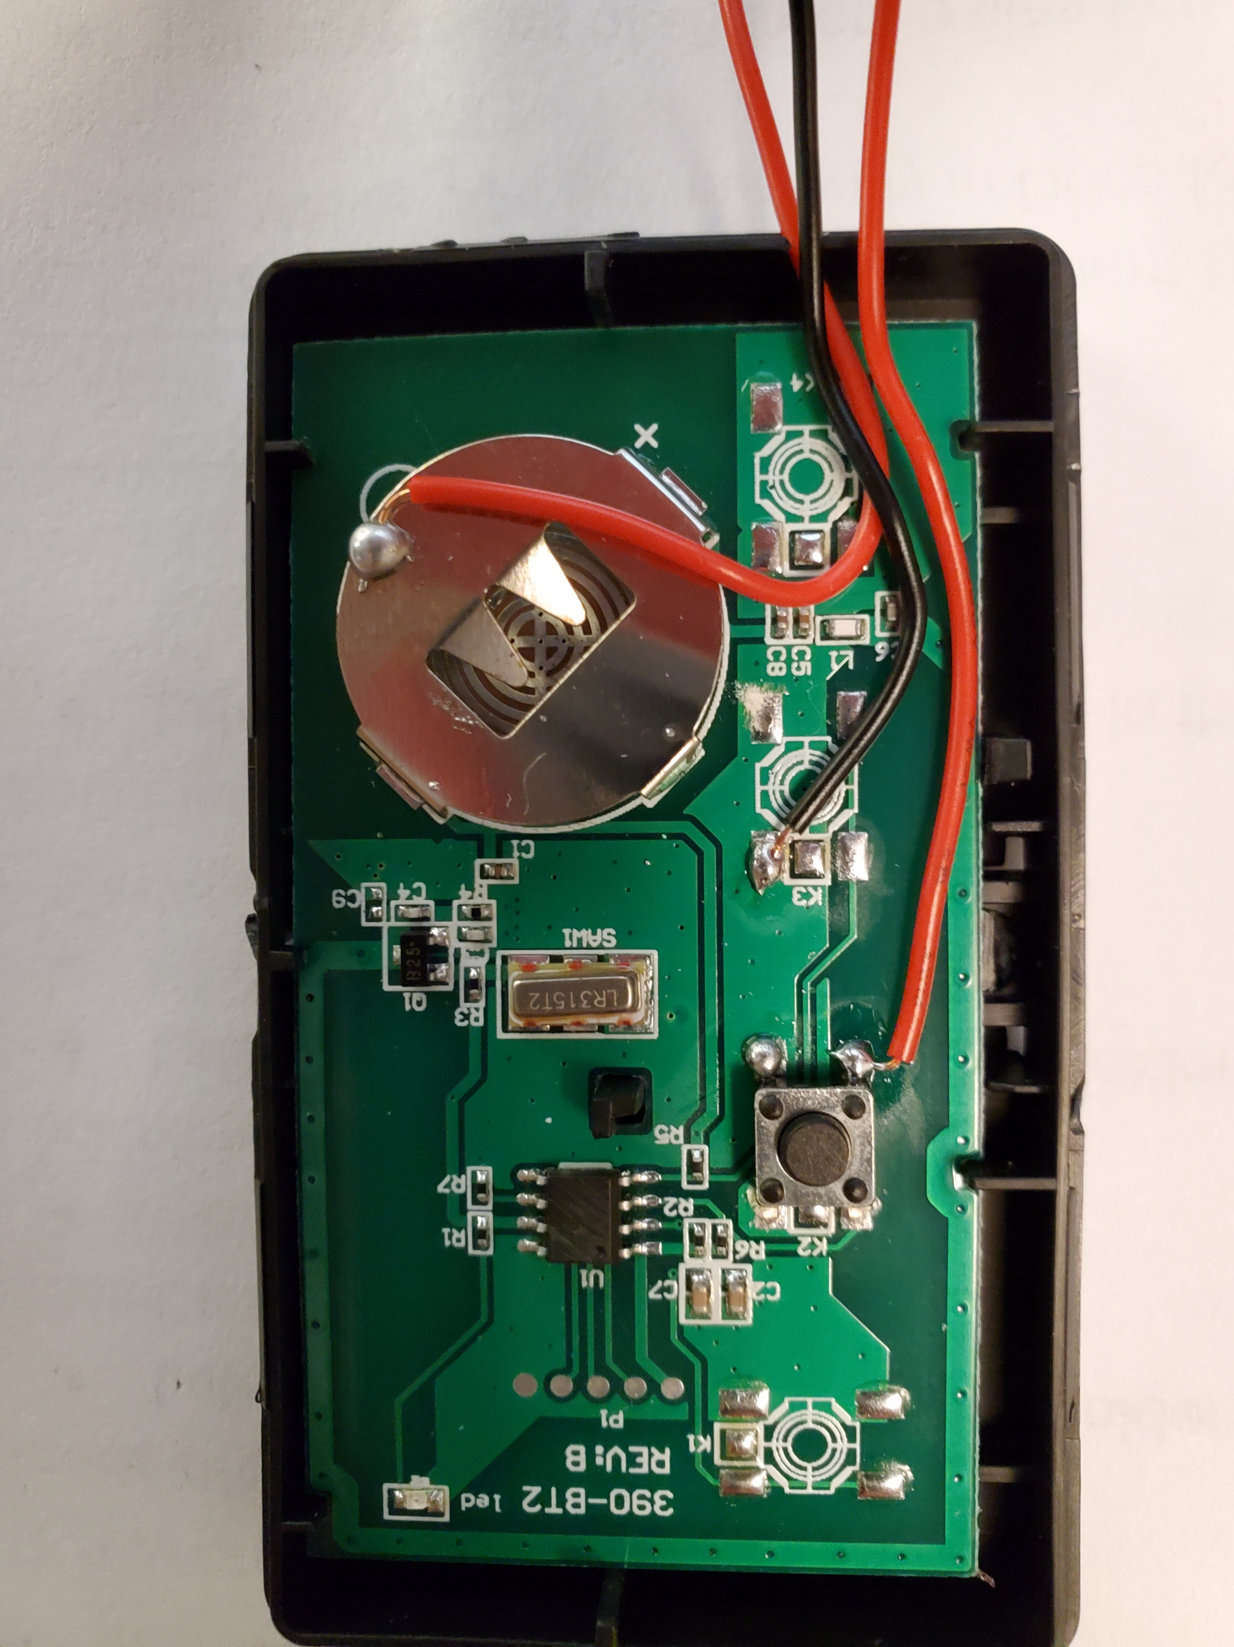
Opener Battery +
Opener Ground
Opener Button

Slide 3
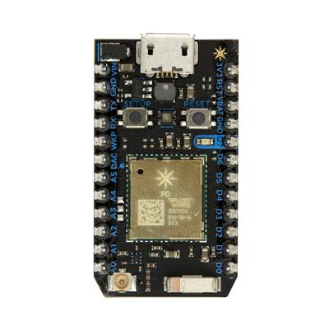
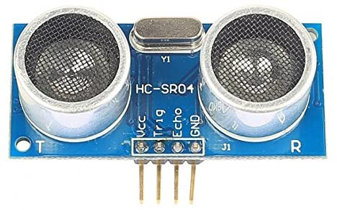

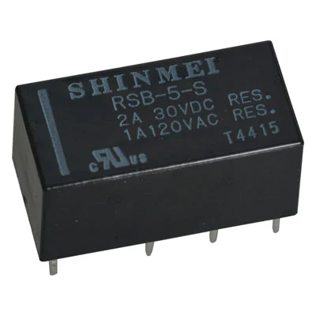

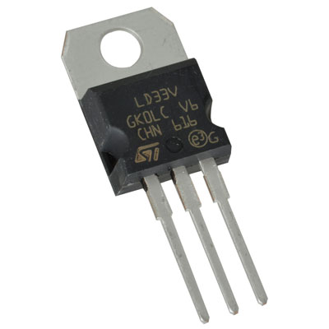
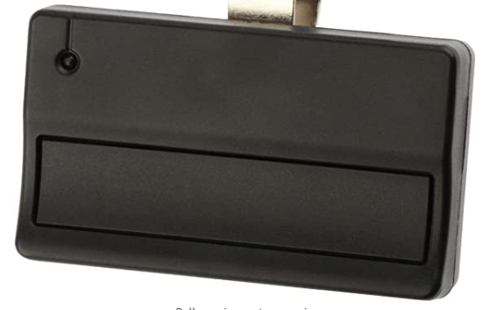
Project Hardware
Particle
Photon
Particle.variable()
Particle.function()
Particle Cloud
1
Particle REST API
https: GET
https: POST
2
Relay
3V Power
Regulator
Garage Door Controller App
Android
smartphone
Wireless I/O Board

